Slide 1
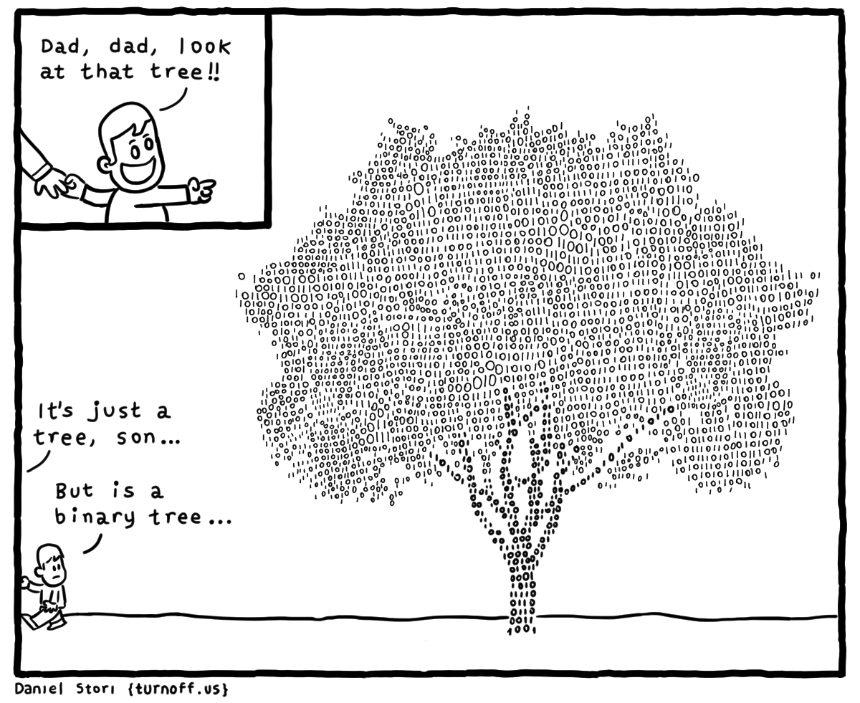
Binary Search Trees
“We pretend that the brain is binary, like a computer. But it's not. It's completely holographic."
-Jim Harrison
CLRS, Sections 12.1 – 12.3

Slide 2
The Problem with Linear Data Structures
Accessing an item from a linear data structure takes O(n) time for an arbitrary element.
Binary trees can improve upon this and reduce access to O(log n) time for the average case.
Expands on the binary search technique and allows insertions and deletions.
Worst case degenerates to O(n) but this can be avoided by using balanced trees (AVL, Red-Black trees).

Slide 3
Binary Search Trees
A binary search tree is a binary tree which satisfies the binary-search-tree property:
For all nodes in the tree, x:
x.leftchild().key < x.key : The key of the left child is less than the key of its parent.
x.rightchild().key ≥ x.key : The key of the right child is greater than or equal to its parent.
<
6
2
>
9
1
4
=
8

Slide 4
BST Insertion
Add the following values one at a time to an initially empty binary search tree using the traditional, naïve algorithm:
8 10 3 1 14 6 4 13 7
What is the resulting tree?

Slide 5
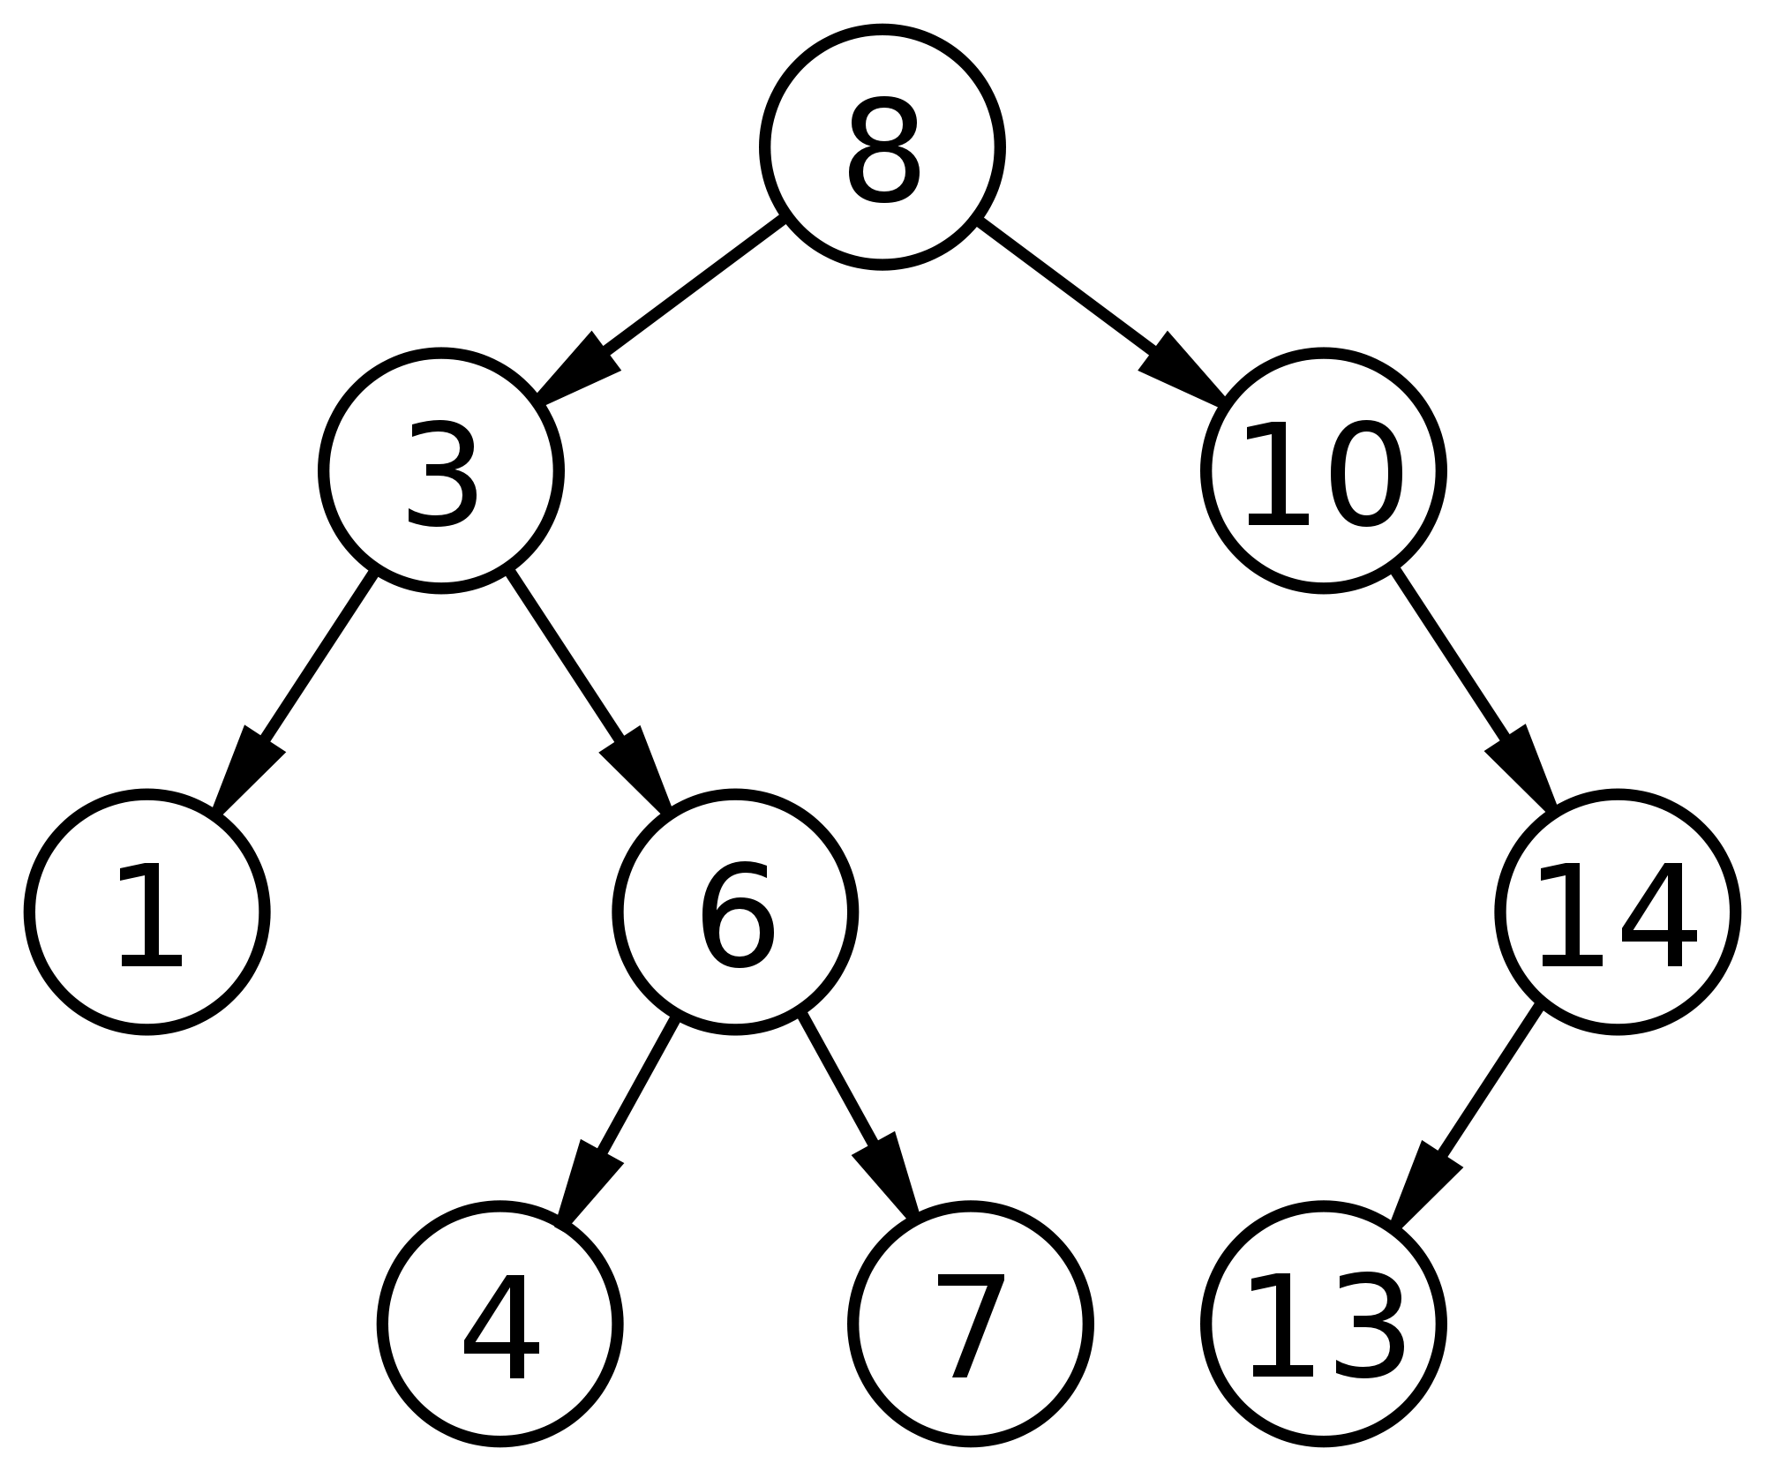
Traversals
What is the result of an in-order traversal of the resulting tree?

Slide 6
Traversals
What is the result of an in-order traversal of the resulting tree?
1 3 4 6 7 8 10 13 14

Slide 7
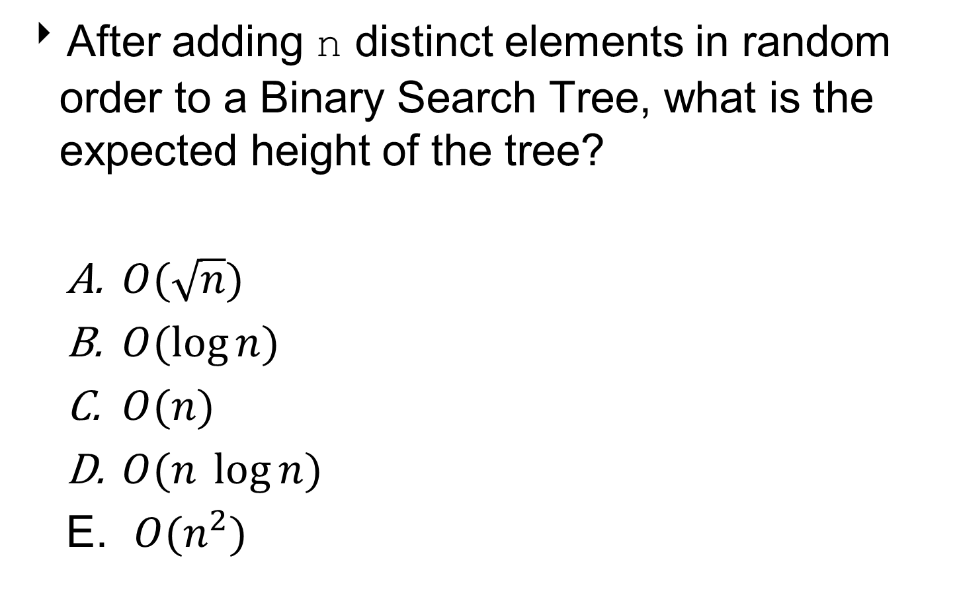
Question 1
After adding n distinct elements in random order to a Binary Search Tree, what is the expected height of the tree?
$O(\sqrt{n})$
$O(\log{n})$
$O(n)$
$O(n \log{n)}$
$O(n^{2})$

Slide 8
Question 1
After adding n distinct elements in random order to a Binary Search Tree, what is the expected height of the tree?
$O(\sqrt{n})$
$O(\log{n})$
$O(n)$
$O(n \log{n)}$
$O(n^{2})$

Slide 9
Worst Case Performance
Insert the following values into an initially empty binary search tree using the traditional, naïve algorithm:
4 7 16 20 37 38 43

Slide 10
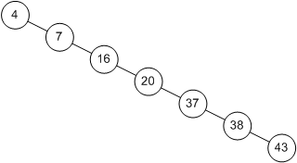
Worst Case Performance
What is the height of the tree?
What is the worst case height of a BST?

Slide 11
Worst Case Performance
What is the height of the tree?
O(n)
What is the worst case height of a BST?
O(n)

Slide 12
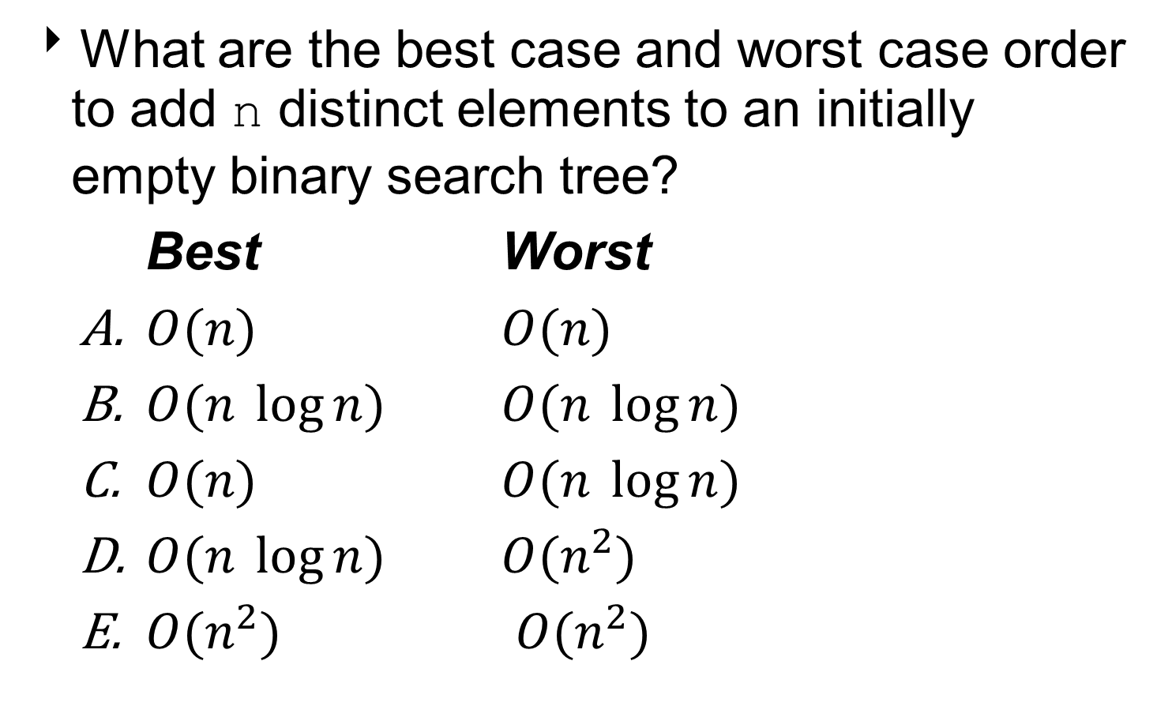
Question 2
What are the best case and worst case order to add n distinct elements to an initially empty binary search tree?
Best Worst
$O(n)$ $O(n)$
$O(n \log{n})$ $O(n \log{n})$
$O(n)$ $O(n \log{n})$
$O(n \log{n})$ $O(n^{2})$
$O(n^{2})$ $O(n^{2})$

Slide 13
Question 2
What are the best case and worst case order to add n distinct elements to an initially empty binary search tree?
Best Worst
$O(n)$ $O(n)$
$O(n \log{n})$ $O(n \log{n})$
$O(n)$ $O(n \log{n})$
$O(n \log{n})$ $O(n^{2})$
$O(n^{2})$ $O(n^{2})$

Slide 14
Querying a BST
Retrieving information from the tree without modifying it.
Search
Minimum, Maximum
All the above operations take O(h) time, where h is the height of the tree.

Slide 15
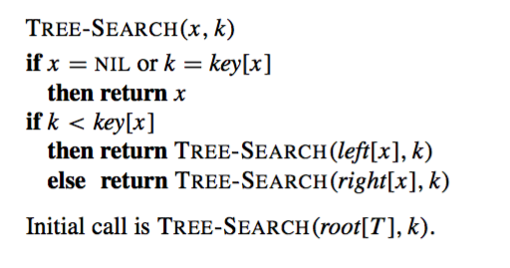
Recursive Searching
Recursive search algorithm, given x a node in the BST and k the target value.

Slide 16
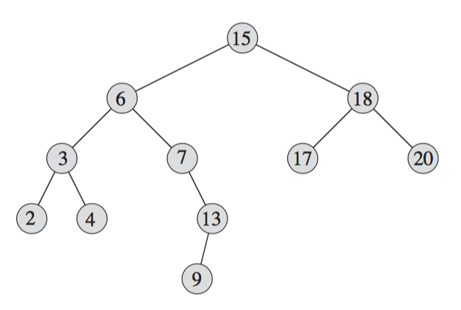
Example: Recursive Searching
Search for the key 13 in the following binary search tree, starting at the root:

Slide 17
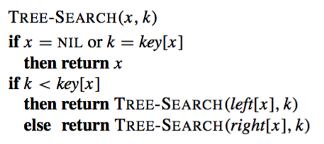
Example: Recursive Searching
r
a
b
c
d
e
f
g
h
i
j
Tree-Search(r, 13)
false
13 < 15 - true
Tree-Search(a, 13)

Slide 18
Example: Recursive Searching
r
a
b
c
d
e
f
g
h
i
j
Tree-Search(a, 13)
false
13 < 6 - false
Tree-Search(d, 13)

Slide 19
Example: Recursive Searching
r
a
b
c
d
e
f
g
h
i
j
Tree-Search(d, 13)
false
13 < 7 - false
Tree-Search(i, 13)

Slide 20
Example: Recursive Searching
r
a
b
c
d
e
f
g
h
i
j
Tree-Search(i, 13)
true
return i

Slide 21
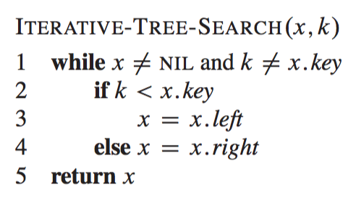
Iterative Searching

Slide 22
Minimum and Maximum
Where are the maximum and minimum key values in a binary search tree?

Slide 23
Minimum and Maximum
Where are the maximum and minimum key values in a binary search tree?
Maximum:
rightmost side node
Minimum:
leftmost side node

Slide 24
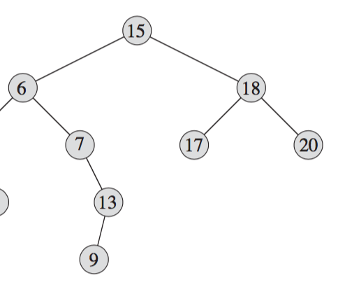
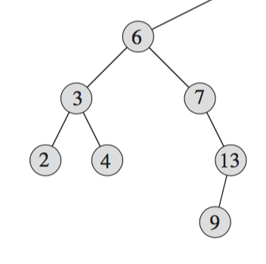
Minimum and Maximum
Minimum and maximum are not always leaves.

Slide 25
Minimum and Maximum
Minimum and maximum are not always leaves
Minimum
Maximum

Slide 26
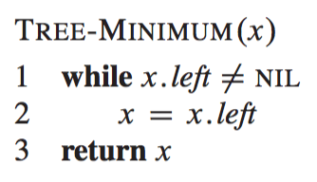
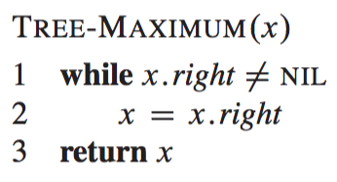
Min and Max Algorithms

Slide 27
Insertion and Deletion
Insertion and deletion operations cause the binary search tree data structure to change.

Slide 28
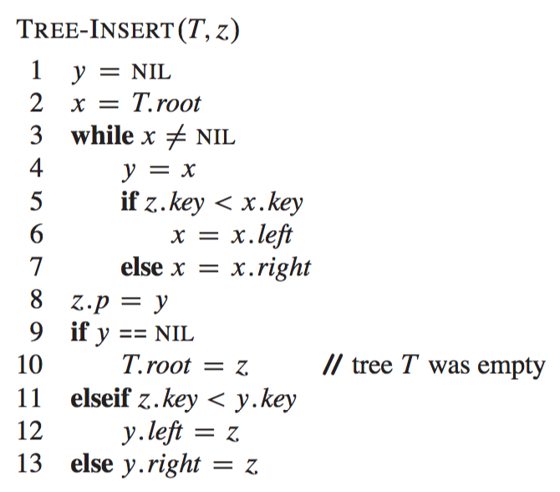
Insertion
Insert the node z in the binary search tree T.
Tree-Insert always insert a new node z as a leaf node.

Slide 29
Insertion
Insert the node z in the binary search tree T.
Tree-Insert always insert a new node z as a leaf node.
Lines 1-7: Find the position to insert the new node

Slide 30
Insertion
Insert the node z in the binary search tree T.
Tree-Insert always insert a new node z as a leaf node.
Lines 1-7: Find the position to insert the new node
Lines 8-13: Set the pointers to insert the new node

Slide 31
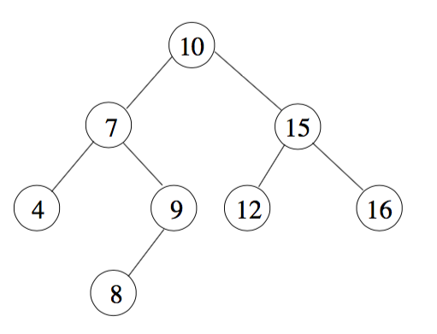
Example: Insertion
Insert a new node z with z.key=11 in the following binary search tree.
z.p = z.left = z.right = NIL, initially.

Slide 32

Example: Insertion
z
T
Tree-Insert(T, z)
r
y = NIL
x = r
false
a
b
y = r
11 < 10 - false
x = b
c
d
e
f
g

Slide 33
Example: Insertion
z
T
r
false
a
b
y = b
11 < 15 - true
x = e
c
d
e
f
g

Slide 34
Example: Insertion
z
T
r
false
a
b
y = e
11 < 12 - true
x = NIL
c
d
e
f
g

Slide 35
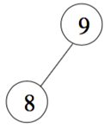
Example: Insertion
T
r
true
a
b
c
d
e
f
z.p = e
false
g
z
11 < 12 - true
e.left = z

Slide 36
Example: Insertion
T
r
a
b
c
d
e
f
g
z

Slide 37
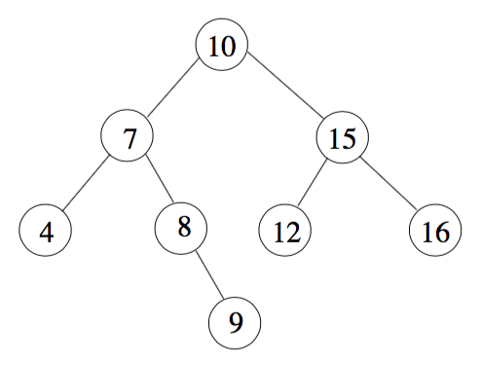
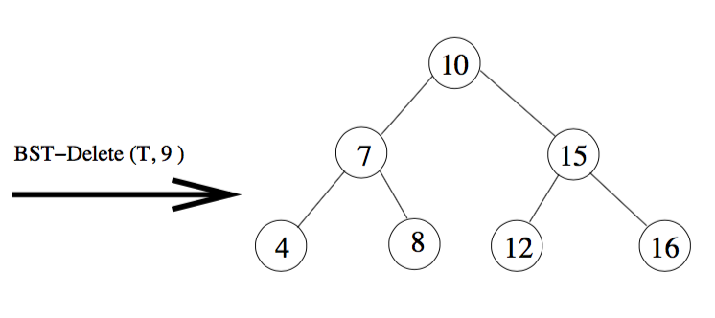
Deletion
Delete the node z from the binary search tree T.
There are three cases:
If z does not have any children, then set the child of z.p to NIL.
r
r
a
b
a
b
c
d
e
f
c
d
e
f
z
d.right = NIL

Slide 38
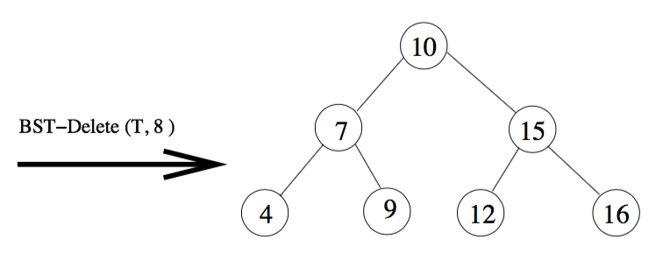
Deletion
If z has one child, then take out z by linking z.p to z’s child.
r
r
a
b
a
b
c
z
e
f
c
g
e
f
g
a.right = z.right = g

Slide 39
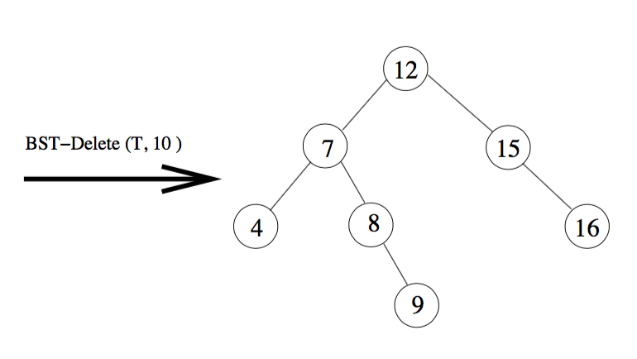
Deletion
If z has 2 children, then substitute z with its successor y (first descendant in right sub-tree with no left child) and substitute y with its right child.
z
e
a
b
a
b
c
d
e
f
c
d
h
f
g
h
13
13
g
b.left = e.right = h
h.p = e.p = b
e.left = z.left = a
e.right = z.right = b
e.p = z.p = NIL

Slide 40
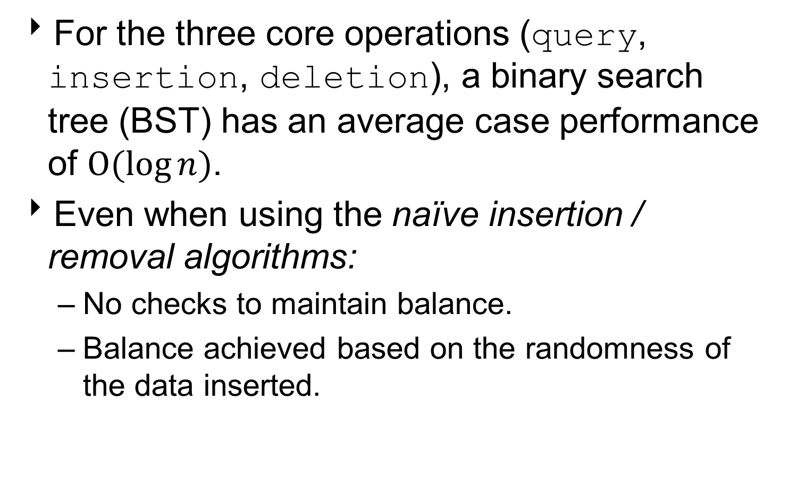
Performance of Binary Trees
For the three core operations (query, insertion, deletion), a binary search tree (BST) has an average case performance of $O(log{n})$.
Even when using the naïve insertion / removal algorithms:
No checks to maintain balance.
Balance achieved based on the randomness of the data inserted.

